Slide 1
DIGITAL PORTFOLIO
NAME : M.YOGAPRIYA
REGISTER NUMBER : 2422J1097
DEGREE : UG
NM ID : asbru062422j1097
DEPARTMENT : BACHELOR OF COMPUTER APPLICATION
COLLEGE NAME : CHIKKANNA GOVT ARTS COLLEGE .
PLACE : TIRUPPUR.

Slide 2
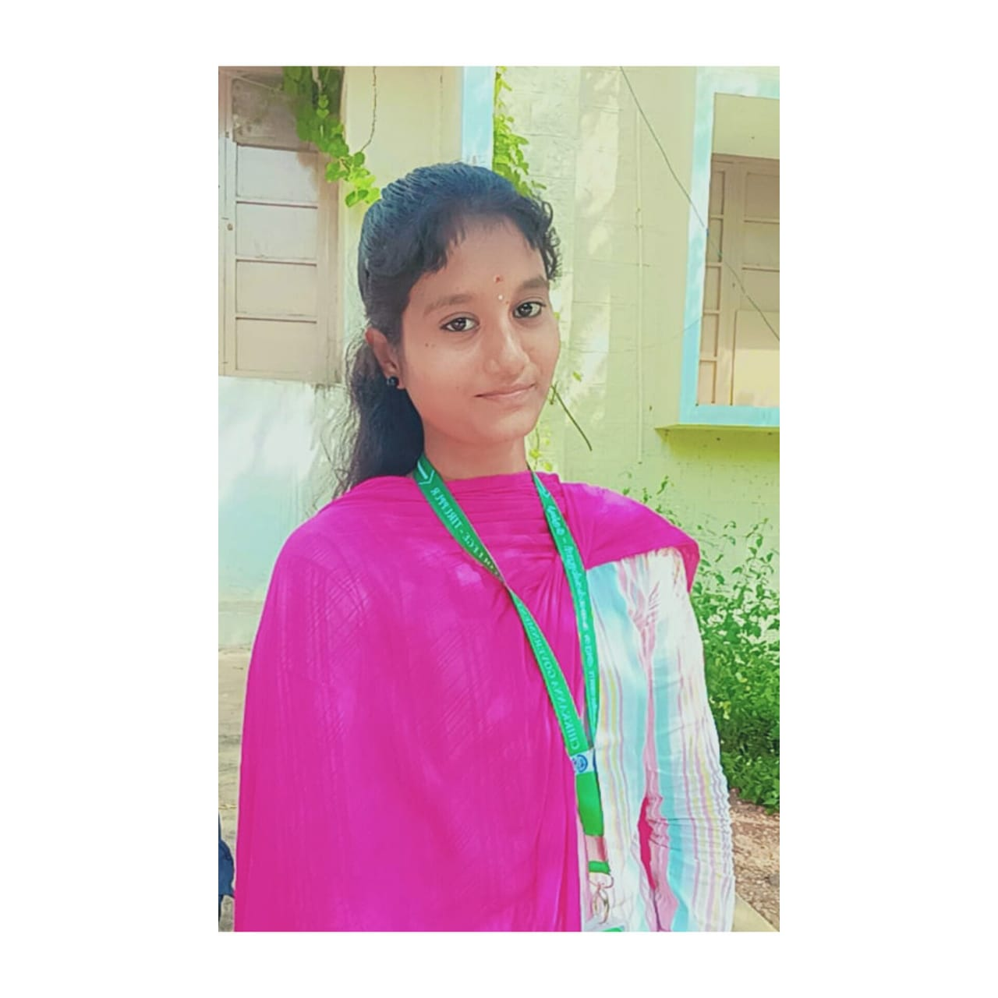
DIGITAL PORTFOLIO
OF
M.YOGAPRIYA

Slide 3

Project Title
A Journey Through My Web Development Portfolio……….
The Creative Journey of Code – Where imagination flows into development and development into real-world impact.”

Slide 4

AGENDA
• Problem Statement
• Project Overview
• End Users
• Tools and Technologies
• Portfolio design and Layout
• Features and Functionality
• Results and Screenshot
•conclusion
• Github link

Slide 5

PROBLEM STATEMENT
Old projects fail to reflect current skills
Users can’t personalize the experience
Brand message appears unclear and inconsistent
Updating content feels time-consuming and tough
The portfolio struggles to reach a wider audience online

Slide 6

PROJECT OVERVIEW
Heading : My Digital Portfolio: Project Overview
Description : A persoMnal website designed to professionally showcase my skills andprojects as a web developer It features a modern,neon-themed aesthetic and a
single-page layout for easynavigation.
Key Sections:
Home : Introduction with a typewriter effect.
About Me: A brief bio and my passion for web development.
Skills : A clear breakdown of my technical and soft skills
Projects : A gallery of my key projects.
Contact : A functional form for direct communication

Slide 7
Who are the End users?
Primary Users:
Potential Employers: Recruiters and hiring managers looking for a developer with specific
skills and a strong portfolio.
Collaborators : Other developers or designers seeking to partner on projects.
Clients : Individuals or businesses in need of web development services.
Secondary Users:
Anyone interested in my work, academic background, or professional journey.

Slide 8
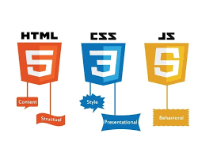
TOOLS AND TECHNOLOGIES
Core Languages:
HTML : The fundamental structure of the website.
CSS : For all styling, layout, and visual effects (including the neon theme and animations).
JavaScript: For interactivity, page navigation, form validation, and the typewriter effect.
Other Tools:
VS Code : My primary code editor.
Git & GitHub: For version control and project hosting.

Slide 9

PORTFOLIO DESIGN AND LAYOUT
Design Philosophy: The design is based on a "Dark Mode Neon“
theme to create a modern and visually striking experience.
The use of vibrant colors likecyan (#00ffff) and magenta (#ff00ff)
against a dark background highlights key elements.Layout:
It’s a single-page application (SPA) style portfolio.
Navigation : A fixed header with a smooth-scrolling menu.
Responsiveness : The layout is designed to be mobile-friendly, adapting to different
screen sizes.

Slide 10

FEATURES AND FUNCTIONALITY
• Project filtering and categorization.
• Image and video galleries.
• Interactive demos and prototypes.
• Downloadable resume and documents.
• Contact form and social media integration

Slide 11
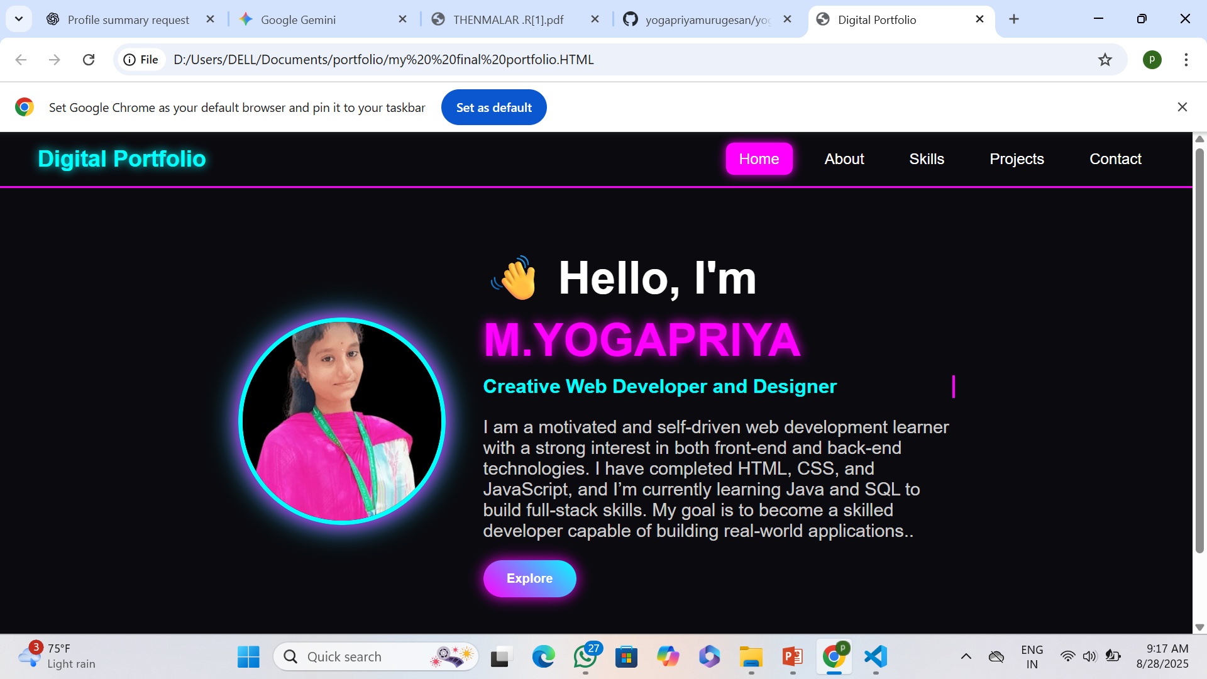
RESULT AND SCREENSCHOT
• Visual proof of accomplishments.
• Showcase project outcomes.
• Demonstrate design and development skills.
• Highlight key features and functionalities.
• Provide context for user experience.

Slide 12
CONCLUSION
Summary: This digital portfolio is more than just a resume;
it is a testament to my skills and a living document of my growth as a developer.
Final Statement: It showcases my passion for creating clean
,user-friendly, and visually appealing web experiences, proving my capability and readinessfor new challenges in the field of web development.
T
.

Slide 13
GITHUB LINK
Source Code Availability – Complete project code is uploaded on GitHub Complete project code is uploaded on GitHub .
Repository Link- https://github.com/yogapriyamurugesan/yogapriya-TNSDC-FWWD-DP.git
Documentation - Detailed README with project setup , features and usage.
Version Control – Project managed using Git & GitHub for tracking changes
Collaboration – Enables teamwork and contributions from other developers
Updates & Maintenance – Regular commits and updates available on GitHub.

Slide 14


